Slide 1
‘Creative talents crossing borders’
9th Gymnasium of Heraklion.
Crete, Greece

Slide 2
The Greek educational system

Slide 3
EXPLORATION OF THE INDIVIDUAL STARTING POINTS FOR YOUNG PEOPLE IN GREECE
GYMNASIUM (PROFESSION CHOICE – JOB MARKET)
Subjective Factors:
Special Skills, interests, capacities, unemployment rate...
General High School
Vocational High School
Vocational education and Laboratory training (ΕΕΕΕΚ)
Following the 1st Grade
1st, 2nd, 3rd grade
VOCATIONAL SECONDARY
INSTITUTE POWERED BY
UNEMPLOYEMENT OFFICE
Α’ grade Cycles
Orientations
Humanities/Sciences/Technology
Β’ grade Orientations
A TWO YEAR COURSE
( INSTRUCTION+ PRACTICE)
C’ grade Specialization
4th year
Optional training
9 months of Instruction and Practice
School Internal Exams
School Internal Exams
Certificate of secondary Education
Panhellenic National Examinations-VOCATIONAL HIGH SCHOOL
Certificate of Secondary Education
(Vocational High School)
Panhellenic National Examinations
TECHNOLOGICAL EDUCATIONAL INSTITUTES
HIGHER EDUCATIONAL INSTITUTES
SECONDARY VOCATIONAL INSTITUTES
TECHNOLOGICAL EDUCATIONAL INSTITUTES
POST SECONDARY INSTITUTES
HIGHER EDUCATIONAL INSTITUTES
Α Γ Ο Ρ Α Ε Ρ Γ Α Σ Ι Α Σ

Slide 4
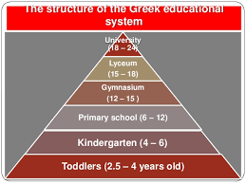
The Greek educational system is divided into 3 levels
Primary education
Secondary education
Higher Tertiary education
Post-graduate education

Slide 5
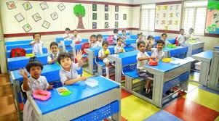
The Primary education
Primary school ( compulsory education)
Kindergarden : 1-2years( ages 4-6)
Primary school: 6 years ( ages 6-12)

Slide 6
The primary education/ teaching subjects
Grading system: 1st and 2nd year : no grades
3rd and 4th year: A to C. 5th and 6th year: 1-10
Subjects
Modern Greek language
Mathematics
History
Environmental studies
Music
Art
English
German or French

Slide 7
The Secondary education
3 grades: 12-15 Junior High School ( ages 12-15), compulsory.
3 grades : 15-18 High School (ages 15-18), non compulsory
Grading system: 1-20 ( base grade: 10, excellent: 20 )
Students take overall written exams at the end of the year which are considered in the average grade.
A students attends the school that is located in his neighborhood unless he has a special interest in art, music or sport or special needs.

Slide 8
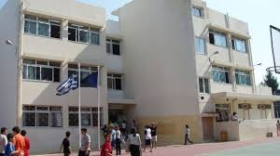
General Gymnasiums and Lyceums – 9 Types
Music ( after passing exams)
Art ( after passing exams)
Experimental (through a lottery system)
Church
School for students with special needs
European school( after passing exams on a language.)
Second chance schools ( aimed at people aged +18 who have not completed compulsory secondary education)
Night school ( holds classes in the evening for people who work during the day.
Intercultural Junior High school ( offers courses to students with migrant background)

Slide 9
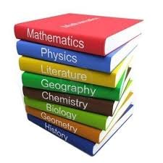
The basic teaching subjects
Modern Greek Language
Modern Greek Literature
Ancient Greek Language
Ancient Greek Literature
History
Mathematics
Physics
Chemistry
Biology
Geography
Religion
English and German or French
Arts
Musik
Physical education
Computer studies
Technology
Social and Political studies
Home economics
Project

Slide 10
Vocational Lyceum. EPAL- Vocational education and laboratory training. 3years. 4th optional training ( instruction and practice)
COMMON GENERAL
EDUCATION COURSES
ORIENTATION GROUP MODULES
Technological
Applications
Management and
Economics
Agriculture, Food Technology
and Nutrition
Maritime
Professions

Slide 11
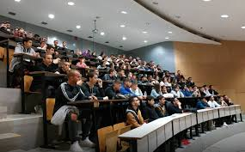
Higher Tertiary education
Higher Tertial Education, undergraduate studies( non compulsory) after sitting Panhellenic national examinations.
University departments ( mainly 4 years, 6 years in medical schools,5 years in school of fine arts)
Technical University, Polythechnic ( 5 years, engineering, architecture,applied sciences))
Technological Educational Institutes ( 4 years or 5 years)
2 semesters. 4-6 mandatory lessons. Non compulsory lessons can be taken.
Post-graduate education: MSc ( 1-2 years),PhD ( 3-6 years)

Slide 12
Some Characteristics of the Greek educational system
All levels of the Greek Educational system are overseen by the Ministry of Education and Religious Affairs.
Public schools and Universities do not charge tuition fees or textbooks
Private tutorial schools offer alongside the state education foreign language lessons, supplementary lessons for weak students, preparation courses for the Panhellenic National examinations.
Education can be provided by private organizations only in the primary and secondary level. The private schools are also supervised by the Ministry.
In addition to public Tertiary institutions private colleges provide undergraduate and post graduate studies collaborating with European Union Universities

Slide 13
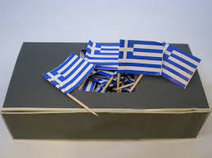
School days
Days/teaching hours: Monday – Friday. 8.15-14.10
Teaching session: 45 minutes
Duration of brakes: 5-10 minutes
Vacation: Christmas 2 weeks, Easter 2 weeks. Summer July, August.
National holidays:28/10, 25/03,17/11, 1/5

Slide 14
Thank you for your attention!

